Slide 1
Software architecture
The design process for identifying the sub-systems making up a system and the framework for sub-system control and communication is architectural design.
The output of this design process is a description of thesoftware architecture.
The architectural design is concerned with establishing a basic structural framework for a system.
It involves identifying the major components of the system and the communications between those components

Slide 2
Architectural design
An early stage of the system design process.
Represents the link between specification and design processes.
Often carried out in parallel with some specification activities.
It involves identifying major system components and their communications.

Slide 3
Architectural design activities
System structuring: The system is structured into a number of principal sub-systems where a sub-system is an independent software unit. Communications between sub-systems are identified.
Control modelling: A general model of the control relationship between the parts of the system is established.
Modular decomposition: Each identified sub-system is decomposed into modules. The architect must decide on the types of the module and their interconnections.

Slide 4
System structuring
The first phase of the architectural design activity is concerned with decomposing a system into a set of interacting sub-systems.
At its most abstract level, an architectural design may be depicted as a block diagram where each box in the diagram represents a sub-system.
Boxes within boxes indicate that the sub-system has itself been decomposed to sub-systems.
Arrows mean that data and/or control is passed from sub-system to sub-system in the direction of arrows.
It presents an overview of the system structure.

Slide 5
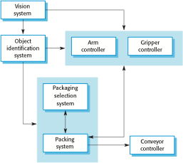
The architecture of a packing robot control system

Slide 6
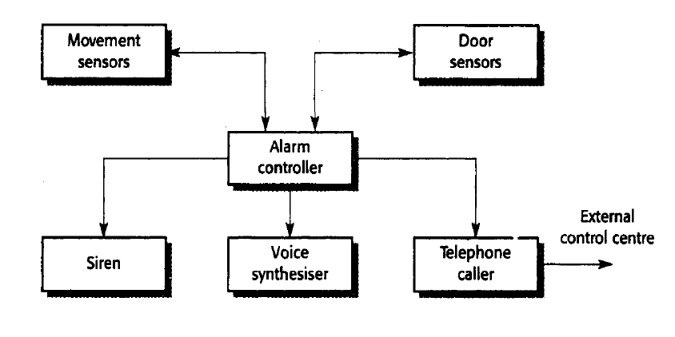
The architecture of a intruder alarm system

Slide 7
Architectural abstraction
Architecture in the small is concerned with the architecture of individual programs. At this level, we are concerned with the way that an individual program is decomposed into components.
Architecture in the large is concerned with the architecture of complex enterprise systems that include other systems, programs, and program components. These enterprise systems are distributed over different computers, which may be owned and managed by different companies.

Slide 8
Advantages of explicit architecture
Stakeholder communication
Architecture may be used as a focus of discussion by system stakeholders.
System analysis
Means that analysis of whether the system can meet its non-functional requirements is possible.
Large-scale reuse
The architecture may be reusable across a range of systems
Product-line architectures may be developed.

Slide 9
Architecture and system characteristics
Performance
Localise critical operations and minimise communications. Use large rather than fine-grain components.
Security
Use a layered architecture with critical assets in the inner layers.
Safety
Localise safety-critical features in a small number of sub-systems.
Availability
Include redundant components and mechanisms for fault tolerance.
Maintainability
Use fine-grain, replaceable components.

Slide 10
System Structuring: Repository model
Sub-systems must exchange data. This may be done in two ways:
Shared data is held in a central database or repository and may be accessed by all sub-systems;
Each sub-system maintains its own database and passes data explicitly to other sub-systems.
When large amounts of data are to be shared, the repository model of sharing is most commonly used a this is an efficient data sharing mechanism.
This model is suited to applications where data is generated by one sub-system and used by another.
Eg: MIS, CAD system

Slide 11
Example: CASE toolset architecture

Slide 12
System Structuring: Repository model: adv/disadv
It is an efficient way to share large amount of data. There is no need to transmit data explicitly from one sub-system to other.
However, sub-systems must agree on repository data model.
Sub-systems which produce data need not be concerned with how that data is used by others.
However, evolution may be difficult as a large volume of information is generated according to an agreed data model. Translating this to a new model is expensive.
Activities such as backup, security, access control and recovery from error are centralized.
However, different sub-systems may have different requirements for above. The repository model forces the same policy on all sub systems.

Slide 13
System Structuring: client-server model
It is a distributed system model which shows how data and processing are distributed across a range of processors. Major components are:
A set of stand-alone servers which offer services to other sub-systems. Eg print servers offer printing services, file server offer file management services etc.
A set of clients that call on the services offered by servers. These are normally sub-systems in their own right.
A network which allows the clients to access these services.
Clients may have to know the names of the available servers and the services that they provide. However, servers need not know either the identity of clients or how many clients there are. Clients access the services provided by a server through remote procedural calls.
Multi user hypertext system to provide film and photograph library

Slide 14
Client-server Model
…
Client 1
Client M
Network
Server 1
…
Server N

Slide 15
Example: Film and picture library

Slide 16
Client-server characteristics
Advantages
Distribution of data is straightforward;
Makes effective use of networked systems. May require cheaper hardware;
Easy to add new servers or upgrade existing servers.
Disadvantages
No shared data model so sub-systems use different data organisation. Data interchange may be inefficient;
Redundant management in each server;
No central register of names and services - it may be hard to find out what servers and services are available.

Slide 17
System Structuring: abstract machine model (layered model)
It models the interfacing of sub-systems.
It organizes a system into a series of layers each of which provides a set of services.
Each layer defines an abstract machine whose machine language (the services provided by the layer) is used to implement the next level of abstract machine.
A well known example of this approach is the OSI reference model.
It supports the incremental development of systems. As a layer is developed, some of the services provide by that layer may be made available to users. This architecture is also changeable and portable.
Structuring system in this way can be difficult. Basic facilities such as file management, which are required by all abstract machines, may be provide by inner layers. Services required by the user may require access to abstract machine that is several levels beneath the outermost layer
If there are many layers, some overhead is always associated with layer management

Slide 18
Layered Model
User Processes
Service Processes
Device Drivers
Kernel

Slide 19
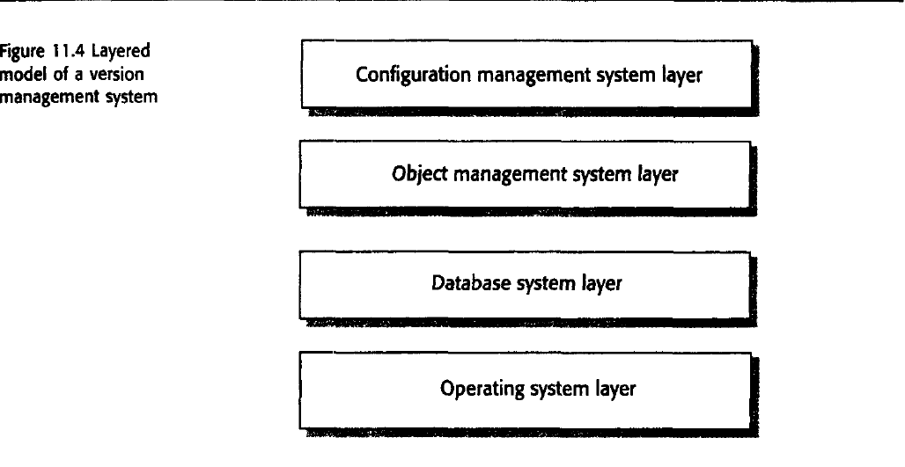
System Structuring: abstract machine model (layered model)

Slide 20
Layered Model
Each layer represents an abstract machine, providing a well defined set of services
Advantages:
promotes an incremental style of development
promotes portability and change
Disadvantages:
cross cutting services, e.g. file handling, do not fit the layered model
multiple layers may lead to performance issues

Slide 21
Control models
The model for structuring a system are concerned with how a system is decomposed into sub-systems.
To work as a system, sub-systems must be controlled so that their services are delivered to the right place at the right time.
Control models at the architectural level are concerned with the control flow between sub-systems.
Two general approaches to control
Centralized control
Event based control

Slide 22
Control models: centralised model
One sub-system has overall responsibility for control and starts and stops other sub-systems.
One sub-system is designated as the system controller and has responsibility for managing the execution of others.
Centralized control models fall into two classes depending on whether the controlled sub-systems execute sequentially or parallel.
The call-return model
The manger model

Slide 23
centralised model: the call return model
It is top-down subroutine model where control starts at the top of a subroutine hierarchy and through subroutine calls, passes to lower levels in the tree.
This subroutine model is only applicable to sequential systems.
Adv: It is relatively simple to analyze control flows and work out how the system will respond to particular inputs.
Disadv: exceptions to normal operation are awkward to handle.

Slide 24
Centralized Control
main
program
subroutine
A
…
subroutine
Z
subroutine
A.1
…
subroutine
A.N
subroutine
Z.1
…
subroutine
Z.N
call-return model

Slide 25
centralised model: the manager model
This is applicable to concurrent systems.
One system component is designated as a system manager and controls the starting, stopping and coordination of other system processes.
A process is a sub-system or module which can execute in parallel with other processes.

Slide 26
Centralized Control
process 1
process 2
manager
process
…
process 3
process N
manager model

Slide 27
Event-driven Control
System behaviour is driven by events, e.g.
external stimuli - sensors
user interactions - mouse clicks, key strokes
process communications - messages from process threads
Example event-driven models:
Broadcast control
Interrupt-driven control

Slide 28
Broadcast Control model
Subsystems are associated, or registered, with specific events – subsystems decide which events to react to
Event & message handler broadcasts events to:
All subsystems OR
Only those subsystems registered for a given event
Advantages:
Ease of system evolution
No need for explicit identification for subsystems
Disadvantages:
Potential conflicts arising from multiple responses to events
Not appropriate for hard real-time systems, i.e. systems which require a response within a fixed time frame

Slide 29
Broadcast Control
…
subsystem-1
subsystem-N
Event and message handler

Slide 30
Interrupt-driven Control
System involves pre-defined kinds of interrupts, i.e. events that cause processing to be interrupted
Each interrupt is mapped onto a special area of memory known as the interrupt vector
The interrupt vector references interrupt handlers, hardware ensures that control is passed to the relevant interrupt handler when an interrupt occurs – a handler will typically start or stop processes
Advantages:
Good for hard real-time systems, i.e. fast & predictable response times
Disadvantages:
Hard to program and validate
Limited by hardware, i.e. upper bound on interrupt vector

Slide 31
Interrupt-driven Control
interrupt
vector
…
Handler 1
Handler 2
…
Handler N
…
Process 1
Process 2
Process N

Slide 32
Modular decomposition: subsytem vs modules
A sub-system is a system in its own right whose operation doesn’t depend on the services provided by other sub-systems.
Sub-system are composed of modules and have defined interfaces, which are used for communication with other sub-systems.
A module is normally a system component that provides one or more services to other modules. It makes the use of services provided by other modules.
In is not normally considered to be an independent system. Modules are usually composed from a number of other simpler system components.

Slide 33
Modular decomposition
There are two main strategies that you can use when decomposing a sub-system into modules.
Object oriented model: You decompose a system into a set of communicating objects.
Data flow model: The system is decomposed into functional modules which accept input data and transform it, in some way, to output data. This is also called a pipeline approach.
In object model, modules are objects with private state and defined operations on that state.
In data flow model, modules are functional transformations.

Slide 34
Modular decomposition: object model
Structures the system into a set of loosely coupled objects with well-defined interfaces.
Objects call on the services offered by other objects.
Rectangles represent the object and dashed arrows indicate that an object uses the attributes or services provided by another object.
Each rectangle (object ) has three sections.
The name of the object class is in the top section.
The class attributes are in the middle section.
The operations associated with the object class are in the lower section of the rectangle.

Slide 35
Modular decomposition: object model
An object oriented decomposition is concerned with object classes, their attributes and operations.
The advantage of the object model are well known. Because objects are loosely coupled, the implementation of objects can be modified without affecting other objects.
Objects are often representations of real world entities so the structure of the system is readily understandable.
Because these real world entities are used in different systems, objects can be reused.
However, to use services, objects must explicitly reference the name and the interface of other objects.

Slide 36
Example: Invoice processing system

Slide 37
Object model advantages
Objects are loosely coupled so their implementation can be modified without affecting other objects.
The objects may reflect real-world entities.
OO implementation languages are widely used.
However, object interface changes may cause problems and complex entities may be hard to represent as objects.

Slide 38
Modular decomposition: data flow models
Data flow models are an intuitive way of showing how data is processed by a system.
Data flow models are used to show how data flows through a sequence of processing steps.
The data is transformed at each step before moving on to the next stage.
Data flows from one to another and is transformed as it moves through the sequence. Each processing step is implemented as a transform.
Input data flows through these transforms until converted to output. The transformations may execute sequentially or in parallel.
When the transformations are represented as separate processes, this model is sometimes called the pipe and filter model

Slide 39
Example: Invoice processing system

Slide 40
Modular decomposition: data flow models: invoice processing system
An organization has issued invoices to customers.
Once a week, payments which have been made are reconciled with the invoices.
For those invoices that have been paid, a receipt is issued.
For those invoices that have not been paid within the allowed payment time, a reminder is issued.

Slide 41
Pipeline model advantages
Supports transformation reuse.
Intuitive organization for stakeholder communication.
Easy to add new transformations.
Relatively simple to implement as either a concurrent or sequential system.
However, requires a common format for data transfer along the pipeline and difficult to support event-based interaction.

Slide 42
Domain specific architectures
Previous models are general models. They can be applied to many different classes of application.
As well as these general models, architectural models which are specific to a particular application domain may also be used.
Although instances of these systems differ in detail, the common architectural structure can be reused when developing new systems.
These architecture models are called domain specific architectures.
Two types
Generic models
Reference model

Slide 43
Reference architectures
Architectural models may be specific to some application domain.
Two types of domain-specific model
Generic models which are abstractions from a number of real systems and which encapsulate the principal characteristics of these systems. Covered in Chapter 13.
Reference models which are more abstract, idealised model. Provide a means of information about that class of system and of comparing different architectures.
Generic models are usually bottom-up models; Reference models are top-down models.

Slide 44
Reference architectures
Reference models are derived from a study of the application domain rather than from existing systems.
May be used as a basis for system implementation or to compare different systems. It acts as a standard against which systems can be evaluated.
OSI model is a layered model for communication systems.

Slide 45
OSI reference model

Slide 46
Generic models
Are abstractions from a number of real systems.
They encapsulate the principal characteristics of these systems.
For example, in real time systems, there might be generic architectural models of different system types such as data collection systems, monitoring system, etc.
The best known example of a generic architectural model is a compiler model.
Thousands of compilers have been written.
It is now generally agreed that compilers should include the following modules.
A lexical analyzer which takes input language tokens and converts them to some internal form
A symbol table, built by the lexical analyzer, which holds information about the names and types used in the program.
A syntax analyzer which checks the syntax of the language being compiled. It uses a defined grammar of the language and builds a syntax tree.
A syntax tree which is an internal structure representing the program being compiled.
A semantic analyzer which uses information from syntax tree and the symbol table to check the semantic correctness of the input program.
A code generator which walks the syntax tree and generates machine code.

Slide 47
Generic models
Symbol table
Lexical analysis
Syntactic analysis
Semantic analysis
Code generation

